Slide 1
LNK Analysis
By Moshe Kaplan

Slide 2
Overview
What is an LNK file?
How do attackers use them?
How can we analyze them?

Slide 3
What is an LNK file?
An LNK is a Windows shortcut file.
It informs the computer to open a file, folder, or program located elsewhere.
Instead of copying a program or file somewhere, create a shortcut to it!
You’ll usually see these on your Desktop and Start Menu

Slide 4
How do attackers use LNK files?
LNKs have several properties which make them useful to attackers. They can:
Run any program on the system.
Run the program with any arguments.
Display any icon on the system.
The .LNK extension is hidden, even when Windows Explorer is configured to display file extensions.
A perfect recipe for a phishing disaster!

Slide 5
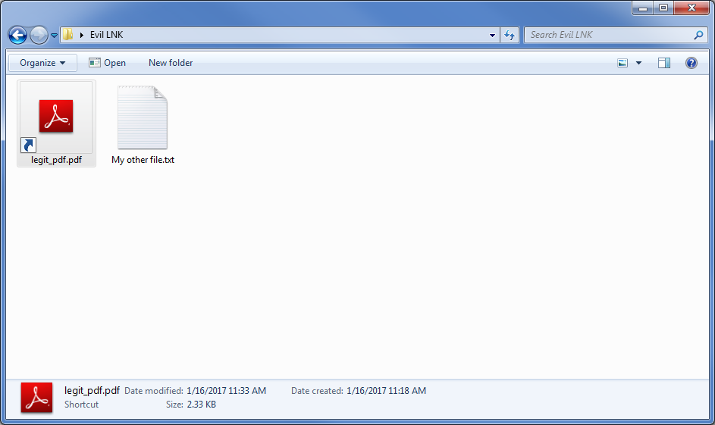
Malicious LNK Screenshot (1/3)

Slide 6
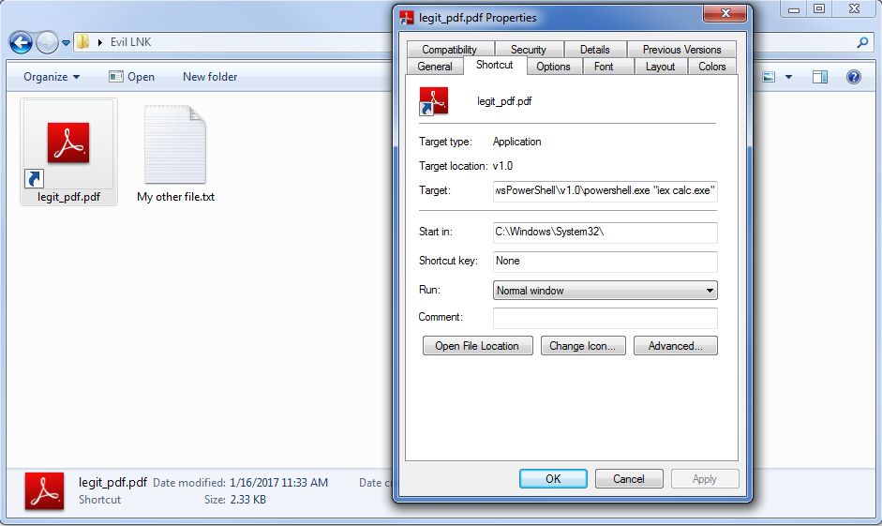
Malicious LNK Screenshot (2/3)

Slide 7
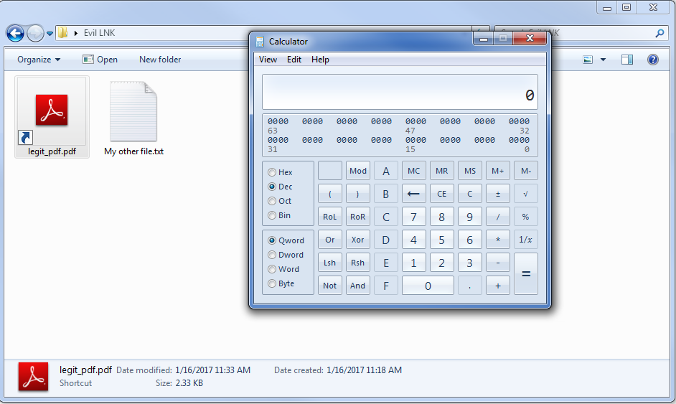
Malicious LNK Screenshot (3/3)

Slide 8
Analyzing LNK Files
Pitfalls:
Cannot examine with Windows Explorer – it truncates the command.
Many tools will attempt to open the LNK’s target instead of the LNK itself.
Solution:
Use a command-line tool.
Drag the LNK into your favorite hex editor.
Use a tool designed to open LNKs.

Slide 9
LNK Analysis Tools
Pylnker
Written in Python
Runs on Windows and Linux
Simple and easy to use
https://github.com/HarmJ0y/pylnker
LECmd (Lnk Explorer Command line edition)
Written in C#
Requires compilation and may not work on Linux
Supports exporting output in many formats
https://github.com/EricZimmerman/LECmd

Slide 10
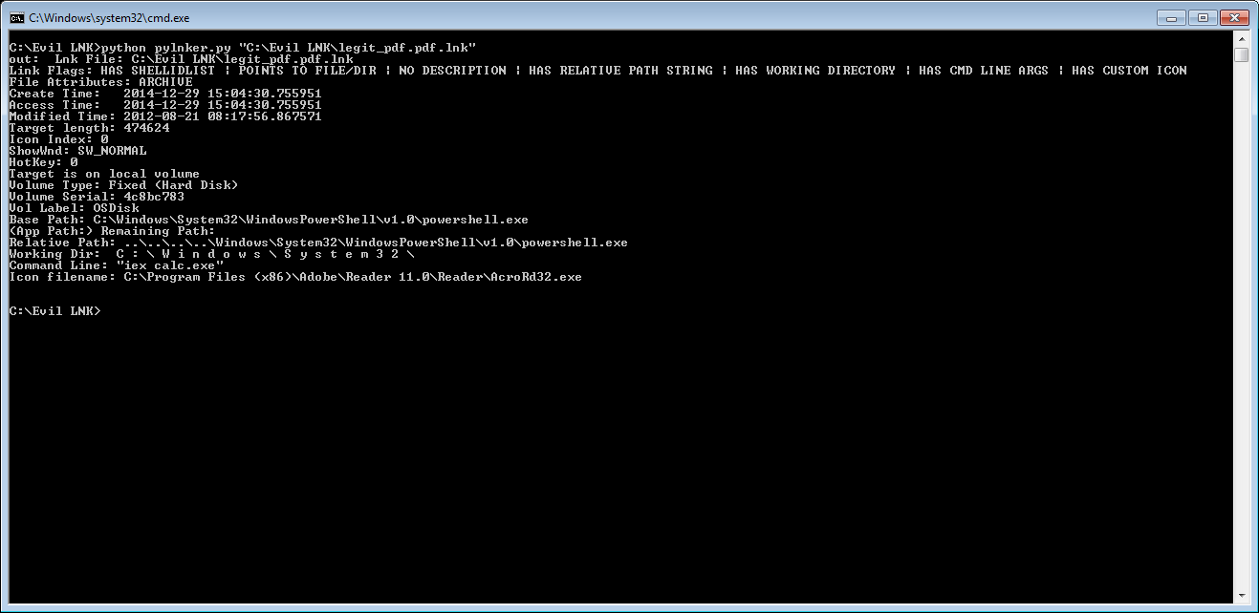
Analysis with Pylnker (1/2)

Slide 11
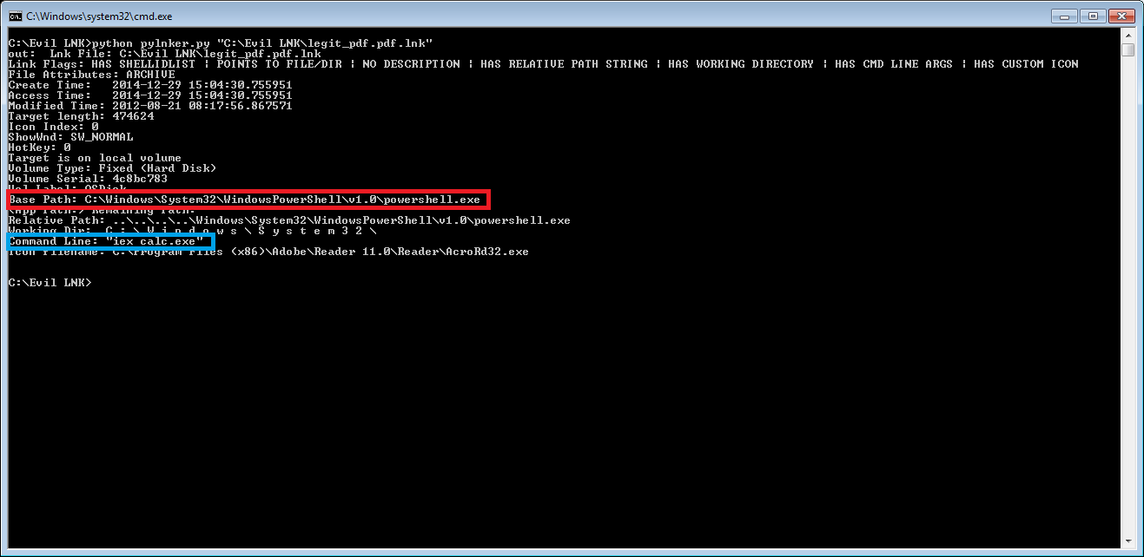
Analysis with Pylnker (2/2)

Slide 12
Preventing LNK-based Infections
Block downloads and emails with LNK files.
Configure your IDS to block archive files (zip/rar/etc.) containing LNK files.

Slide 13
References and Further Reading
Technical Details:
[MS-SHLLINK]: Shell Link (.LNK) Binary File Format - https://winprotocoldoc.blob.core.windows.net/productionwindowsarchives/MS-SHLLINK/[MS-SHLLINK].pdf
Forensics Wiki: LNK - http://forensicswiki.org/wiki/LNK
Past Attacks:
The new .LNK between spam and Locky infection - https://blogs.technet.microsoft.com/mmpc/2016/10/19/the-new-lnk-between-spam-and-locky-infection/
Asruex: Malware Infecting through Shortcut Files - http://blog.jpcert.or.jp/2016/06/asruex-malware-infecting-through-shortcut-files.html
Shortcuts: another neat phishing trick - https://d.uijn.nl/2016/12/28/shortcuts-another-neat-phishing-trick/
“LNK” Attacks are Back Again - https://www.symantec.com/connect/blogs/lnk-attacks-are-back-again
CPL Icon Loading Vulnerability - http://www.geoffchappell.com/notes/security/stuxnet/ctrlfldr.htm
Creating LNKs:
Create Shortcuts .lnk or .url Files With PowerShell - http://powershellblogger.com/2016/01/create-shortcuts-lnk-or-url-files-with-powershell/
LNKs for Post-Exploitation data collection:
You down with LNK? - https://www.trustwave.com/Resources/SpiderLabs-Blog/You-down-with-LNK-

